Slide 1

ANALYSIS OF MOVIES AND TV SHOWS ON NETFLIX
(2008 - 2021)
by
Olarewaju Adeyemo

Slide 2
INTRODUCTION
Netflix is a subscription streaming service and production company in the United States of America. It was founded in 1997 but started streaming operations in 2007 by offering movies and tv shows library through distribution deals and it’s own production.
Netflix is one of the world’s leading entertainment services with 223 million paid membership in over 190 countries.

Slide 3
PROBLEM STATEMENT
Netflix is considering expanding the upload of contents between movies or tv shows and which genre to focus on. The board is having difficulties on the content and genre to choose from so the task was given to the data analyst to look into previous uploads from 2008 to 2021 and recommend a content and genre to invest in.

Slide 4
PROJECT OVERVIEW
To analyse the contents uploaded on Netflix and draw an understanding about how movies and tv shows have been uploaded from 2008 to 2021 to the decision making.

Slide 5
RESEARCH QUESTIONS
How has the trend been between movies and tv shows been over the years?
What are the most popular genres to be uploaded on netflix?
How have various countries contributed to the contents on netflix?
How is the rate of upload of both contents with regards to age ratings?
How frequent has contents been uploaded during the weeks?
Which content on netflix has the oldest release date?

Slide 6
METHODOLOGY
Data Source
Data Preparation
Data Transformation
Visualization
Report

Slide 7
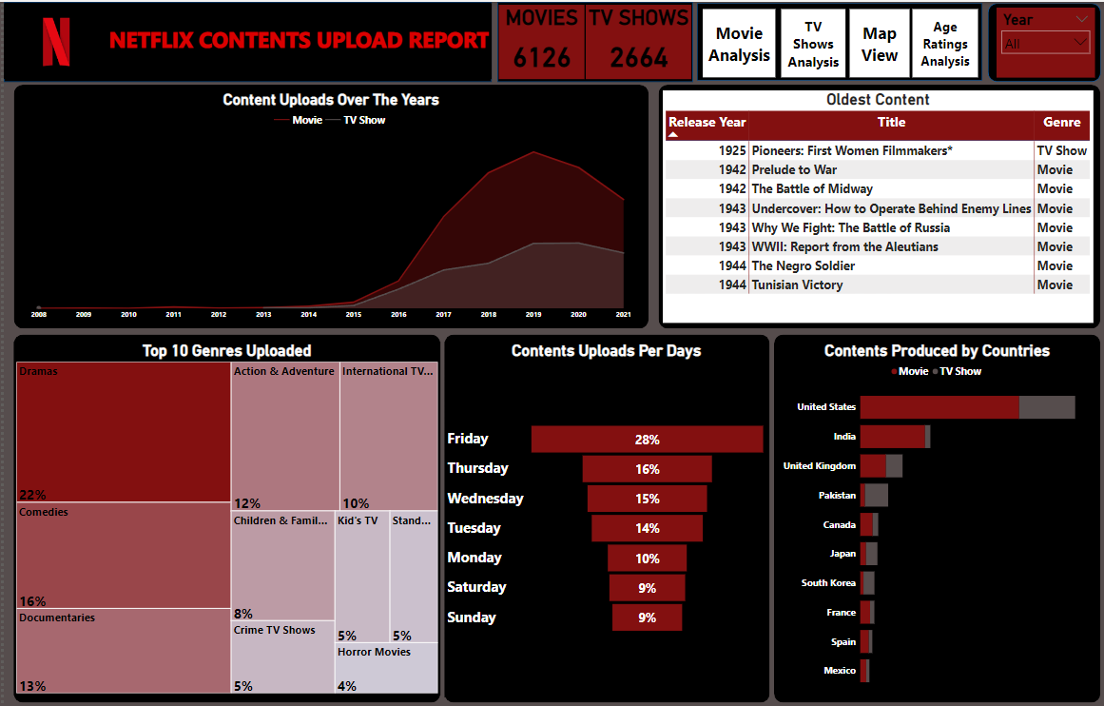
VISUALIZATION

Slide 8
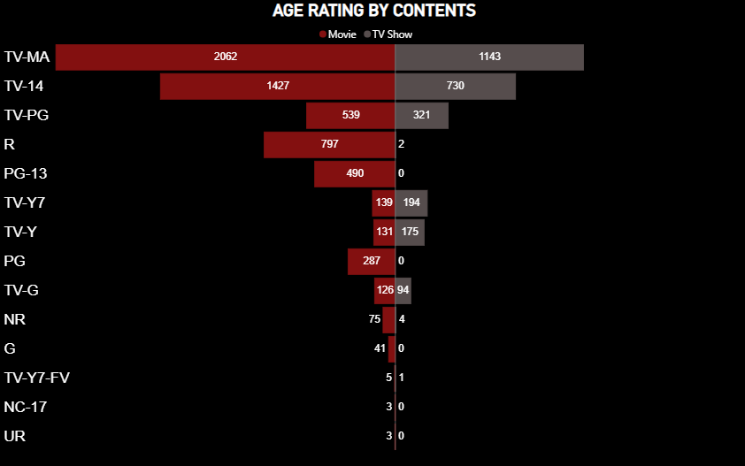

Slide 9
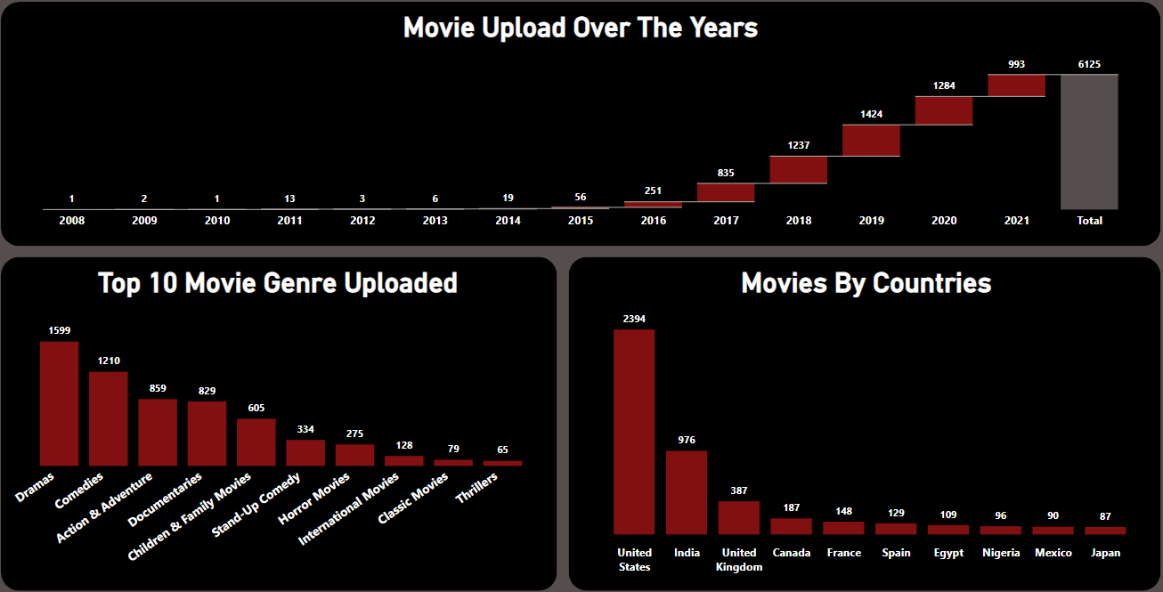

Slide 10
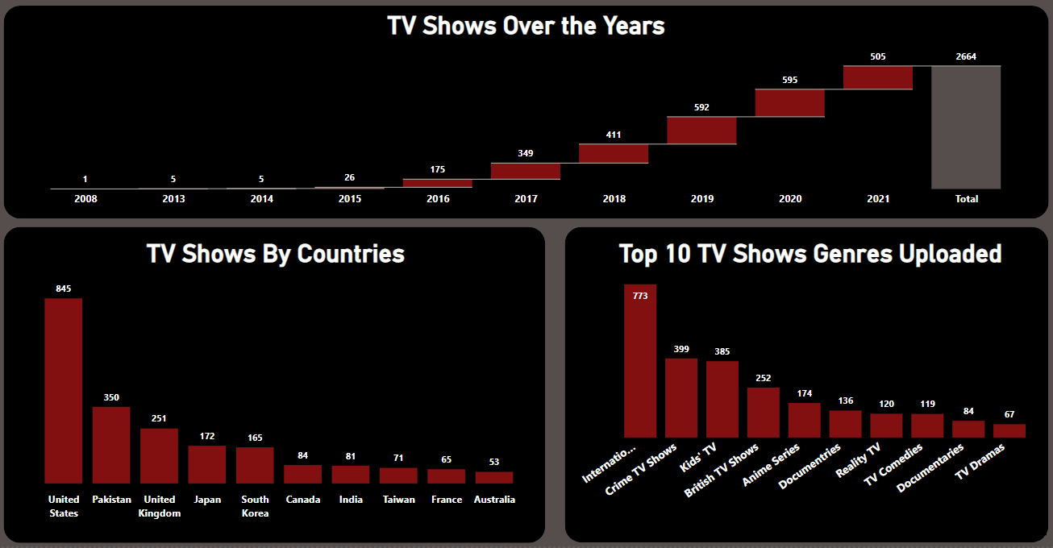

Slide 11
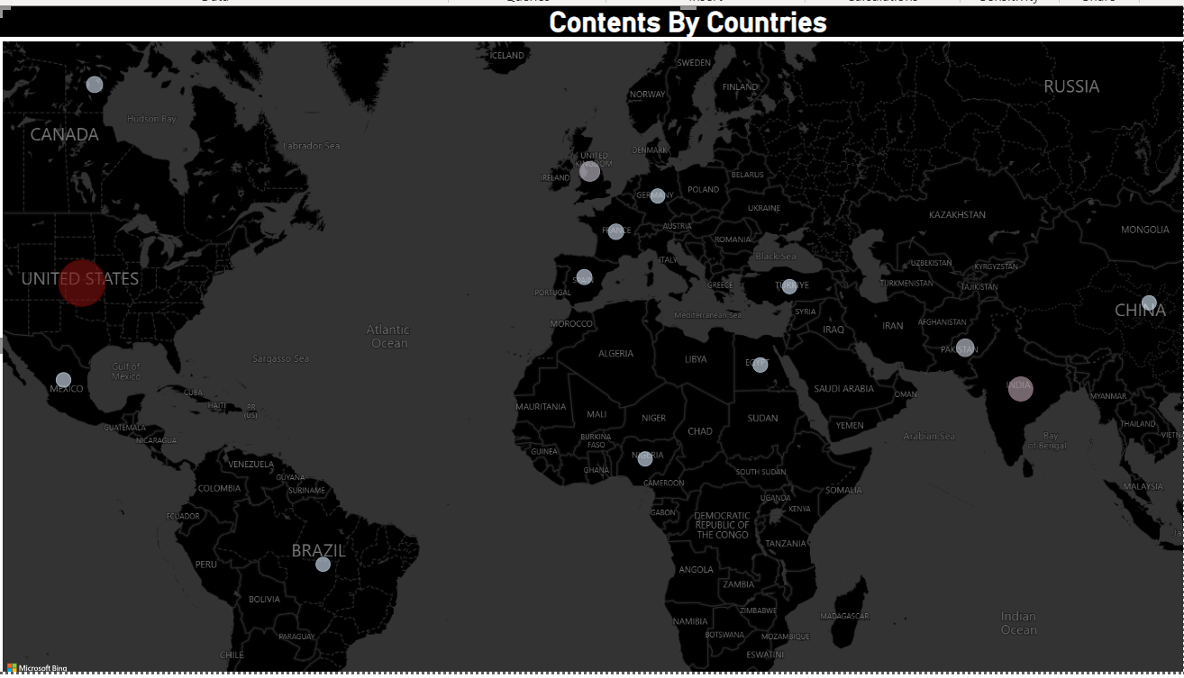

Slide 12
CONCLUSIONS
After 2017 there is a great increase in movie upload compared to tv shows which concludes that viewers watch more of movies than tv shows
Drama have the highest upload in terms of content genres followed by comedy and documentary respectively.
As expected, the United State of America is the country with highest contents on netflix due to the USA being it origin and have the most subscribers.

Slide 13
CONCLUSIONS
Most of the contents uploaded on Netflix has been made towards the end of the week most especially on Fridays. This is due to the fact that it’s the weekend and subscribers are more likely to be able to view movies and tv shows during the weekend.
The oldest content uploaded on Netflix is a tv show titled Pioneers:First Female Filmmakers released in 1925.
TV-MA and TV-14 are the most contents uploaded on netflix in terms of age rating. This shows Netflix have pushed their contents more to the matured subscribers.

Slide 14
RECOMMENDATION
Focus should be placed on movies as the main investment as it what has been uploaded the most overtime and what subscribers have enjoyed the most.
Drama is the movie genre to be invested in as it has proven to be what subscriber view the most by 22%.
Netflix should upload more contents from other countries by producing in or getting more good movies from this other countries to reduce the massive gap with USA and gain more subscribers from other countries.
Contents uploads on fridays should continue and saturdays should be considered because it is the weekend and most subscribers are less busy on weekend.
TV-MA and TV-14 rated movies should continue however producing more movies that suites other age groups should be focused on.

Slide 15
REFERENCE
https://www.kaggle.com/datasets/shivamb/netflix-shows
https://www.color-hex.com/color-palette/22942

